Slide 1
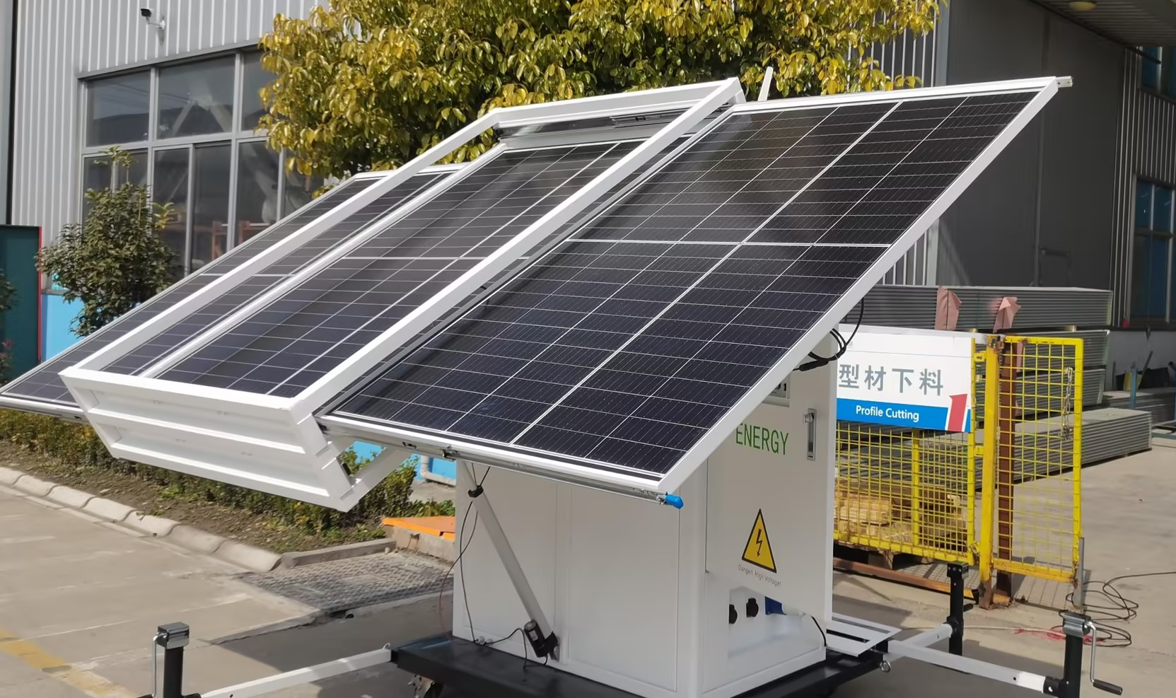
Wind & Solar Residential Energy Storage
HJ-SPW-C Series
The HJ-SPW residential wind and solar energy storage integrated system is a combination of equipment and technology that converts wind and solar energy into electrical energy, supplies household appliances, and stores excess electrical energy for use at night or when there is no electricity. This system can be connected to emergency generators for backup. It can also be applied to communication, used in the field of temporary electricity, agricultural irrigation, emergency disaster relief, medical epidemic prevention, communication exploration and other application scenarios, providing a stable energy supply and backup system for the site.

Slide 2
Wind & Solar Residential Energy Storage
Configuration Table
NO. | Product Name | Specifications | Unit | QTY | Remark | Actual Use
1 | Outdoor Cabinet | 16500*750*750mm(H*W*D),Cabinet frame is made of galvanized material 1.5mm, internal 20mm thick heat insulation; front and back door operation, floor mounting; divided into equipment compartment and battery compartment, 4 casters; | Pcs | 1
2 | Lithium Iron Battery | 3U*482.6*420_48V/100AH_Requires configuration of front screen port and other components, neutral | Pcs | 1 |  | If needed, real batteries need to be configured, and the quantity can be 1-3 sets;
3 | Temperature Control | Fan strong exhaust, DC48V, exhaust volume 300W | Pcs | 1 | Battery compartment
4 | LED Light Strip | Bluetooth intelligent LED light strip (5M+Adapter) | set | 1 | Decorative lights | Optional
5 | Monitor System | Monitoring mainframe (with display screen),APP-operable; | set | 1 |  | Optional
6 | Wind Turbine | Power 600W, 48V system, starting wind speed 2.5m/s, rated wind speed 11m/s,Three-phase AC permanent magnet generator, wind turbine diameter of 1.85 meters | Pcs | 1 | Wind turbine components | Optional
7 | Fan Controller | 1. Specification: 600W, MPPT controller adopts impedance matching adaptive, maximizing energy utilization; 2. Fan overcurrent limit, intelligent maximum battery current limit, RS485 serial communication; 3. Working voltage: 48V, working temperature -20 ℃~55 ℃. 4. Equipped with a resistor unloader. | Pcs | 1
8 | Tower | Matching 600W fan, cable tower 4m | Pcs | 1
9 | PDU | 6 Positions, 10A GB, 19" Mounting, With Switch, 3 Meter Cable | Pcs | 1
10 | PV Inverter | 3KW, off-grid type, AC 220V input & PV DC input; output AC220V; low voltage 48V for energy storage system. | Pcs | 1
11 | Lighting - Inside Cabinet | T5 LED/DC48V (LED type) | Pcs | 1
12 | Fire Protection System | Thermal Aerosol Fire Extinguisher QRR0.1G/S-Q- and Andon, Thermal Line 1.5m, Feedback Line 0.5m | Pcs | 1 | Fire protection inside the cabinet
13 | Photovoltaic Panel | P-type, 405W, monocrystalline silicon, single panel: 1754*1096*30MM Open circuit voltage 41.2V, open circuit current 12.3A | Pcs | 3 |  | Optional
14 | Cameras | DH-IPC Dahua HD 2 million infrared 1080P hemispherical network camera | Pcs | 1 | Optional
16 | Electrical Box | Configure input switches, interfaces, meters, output switches, etc | Pcs | 1
17 | Photovoltaic Converter Bracket Device | Purchase aluminum alloy frame, pull-out type, can install up to 3 photovoltaic panels, photovoltaic panel flipping mechanism, electric push rod 400KG, 24V | Pcs | 1
18 | Diesel Generator | Model, sheet metal shell, size 750X 700X 400mm, single-phase 32A oil engine plug socket | Pcs | 1 |  | Optional, Select according to the usage scenario;

Slide 3
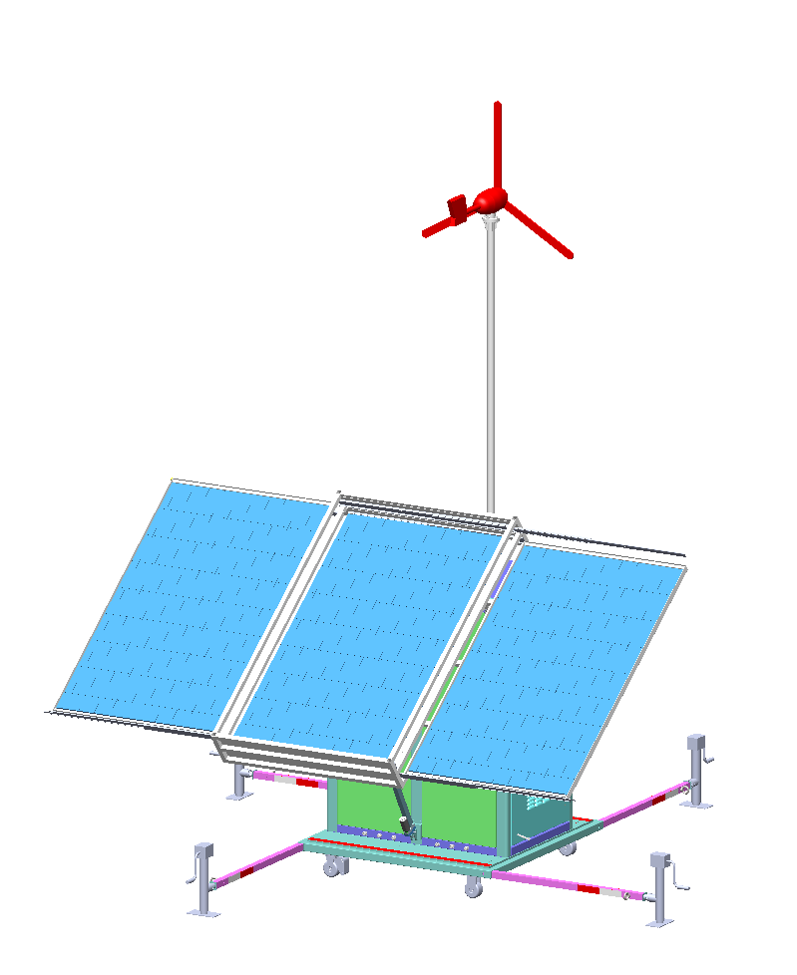
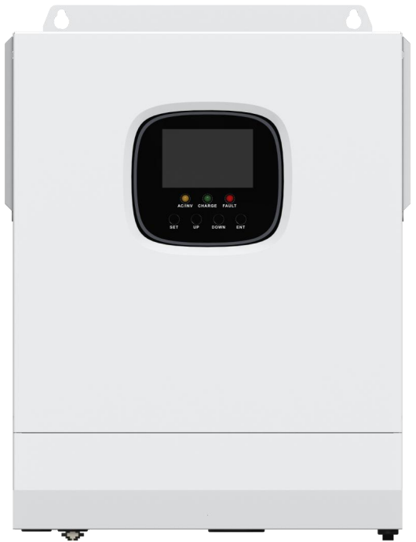
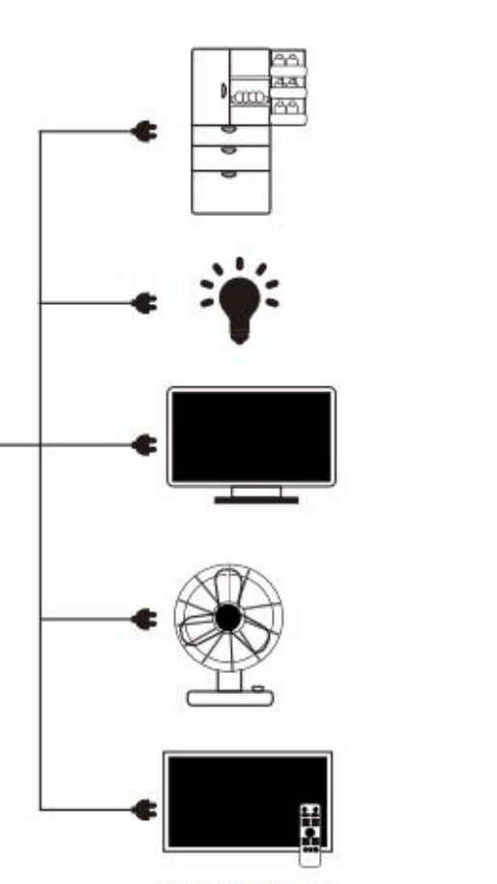
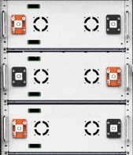
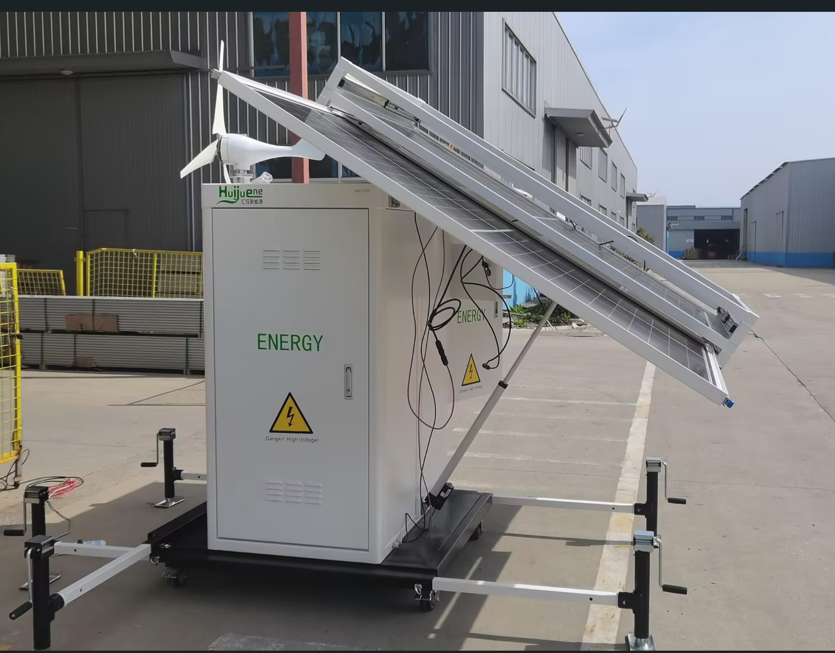
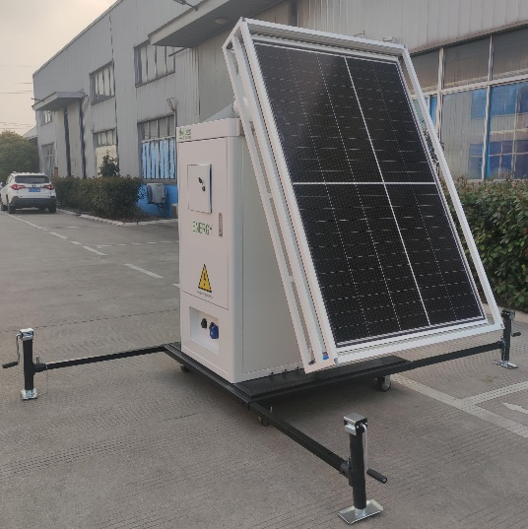
Green Energy Access Schematic
Household Wind Solar Energy Storage ALL-IN-ONE Machine
Wind Power Gneration
Solar Power Generation
PV Inverter
Grid Electricity
Oil Engine Power Generation
重要负载
Lithium Battery Energy Storage Systems/BMS
Product Features
The maximum photovoltaic power generation is 11KWh/day, the maximum wind power generation is 2.5KW/day, and the energy storage battery of 20-30KW is optional;
Multiple introduction modes: supporting photovoltaic charging, wind power charging, mains charging, diesel engine power generation, and can be combined in multiple groups;
Simple and convenient: Foldable photovoltaic modules, movable and easy to transport;
More Space saving: Integrated design, saving space occupancy.
High performance: ultra long cycle life, high safety, high rate output power.
More intelligent: High intelligence battery level monitoring, LCD display, support for mobile app functions

Slide 4
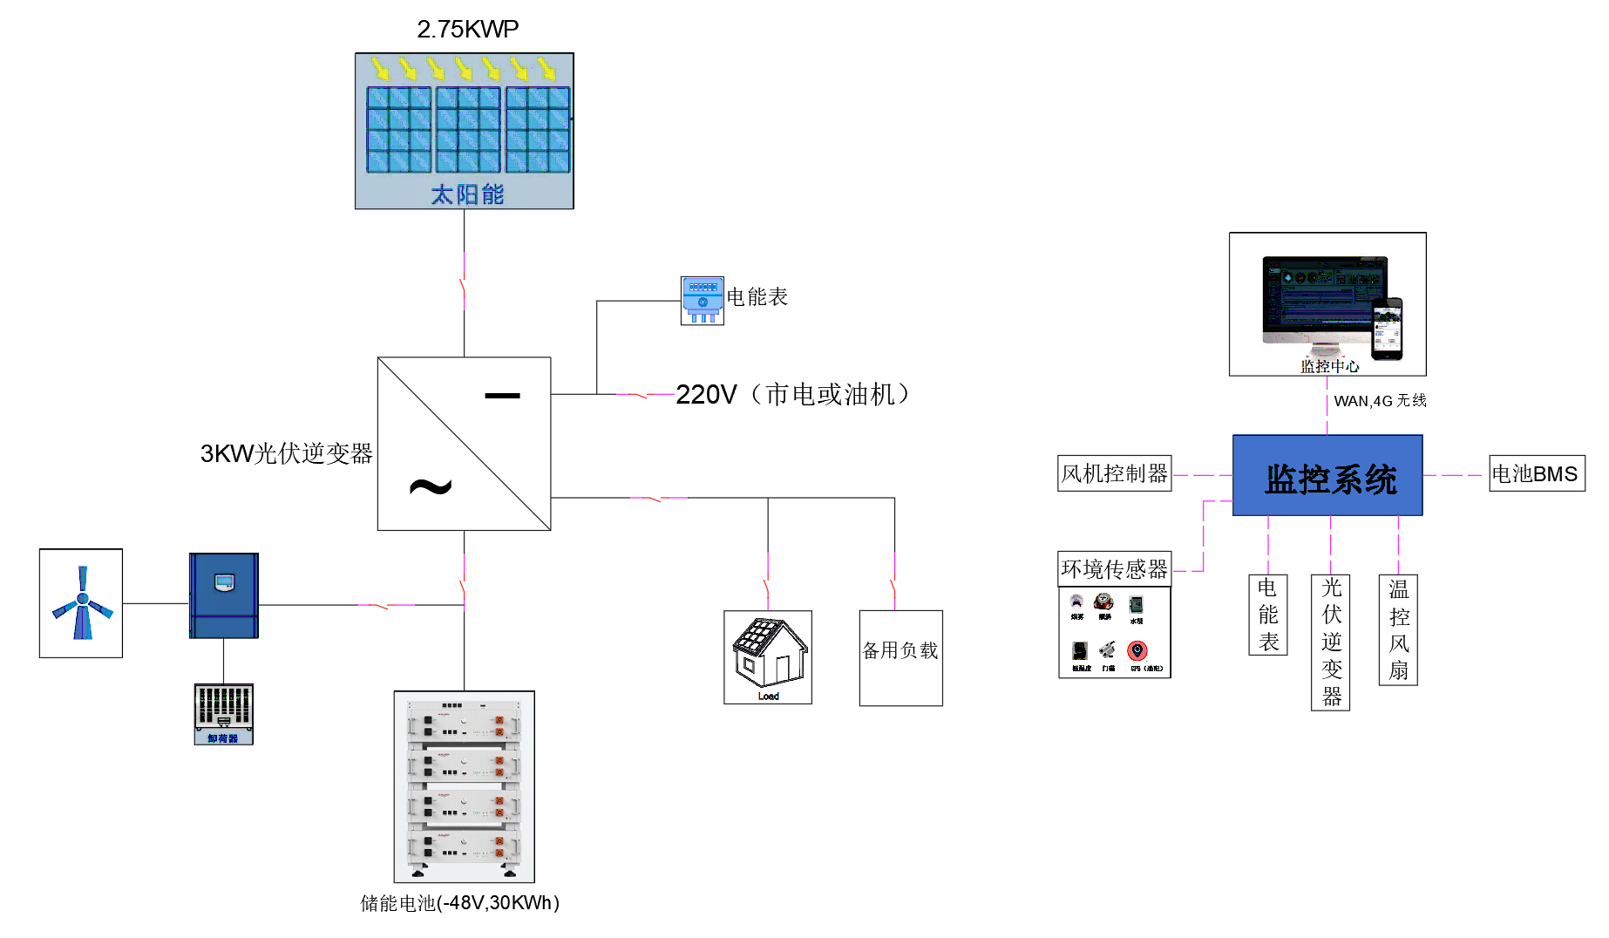
Hybrid Integrated Energy Station (Tech Diagram)
Solar Energy
Electricity Meter
220V Electric Supply/Diesel Engine
3KW PV Inverter
Dump Load
Energy Storage Battery(-48V, 30KWh)
Monitoring Center
Wind Turbine Controller
Monitoring System
Battery BMS
Environmental Sensor
Energy Meter
PV Inverter
Temperature Controlled Fan

Slide 5
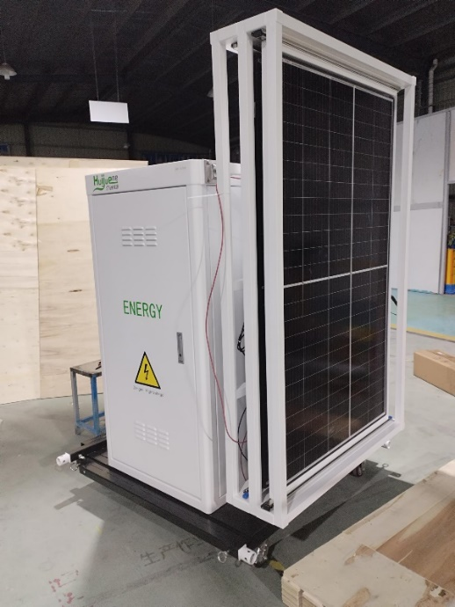
Hybrid Integrated Energy Station (Specifications)
Specifications |  |  | Product Number
NO. | Project Name |  | HJ-SPW-C
 |  |  | Parameter
1 | Environmental Requirements | Operation Temperature | －40～+50℃
 |  | Relative Humidity (RH) | 5% to 95%, Without condensation
 |  | Heat Dissipation Methods | Intelligent temperature-controlled speed regulating fan
2 | Specifications | Size W*D*H | Cabinet size 1650mm*800mm*1250mm Maximum external dimensions 1850*1345*1345mm;
 |  | Main Materials | Aluminum alloy material and Q235 steel plate (Load-bearing parts), surface spray treatment
 |  | Application Scenario | Off-grid, household (Removable), commercial and industrial, etc.;
 |  | Degree of Production | IP54, anti-corrosion C4
 |  | Weight | <500KG (Excluding equipment)
3 | AC Introduction | Input Voltage | Single-phase 85V AC ~ 300V AC / 380V three-phase, 45Hz ~ 66Hz
 |  | Lightning Protection Level | B 60KA
4 | Photovoltaic Introduction | Photovoltaic Capacity | Maximum 2.75KWp, Maximum power generation 11KWh/day
5 | Wind power introduction | Wind Turbine + Controller | Maximum 600W/48V battery system (Optional): Expected power generation of 2.5KWh/day
6 | Load Output | Capacity | Inverter output 3KW~10KW, 1ph, 220V;
7 | Energy Storage System | Lithium Iron Phosphate Battery | 10-30KWh (Optional)
8 | Electricity Generator | Diesel Generator Set | Silent type, fully automatic, AC 380V, 8KW~20KW (Optional)
9 | Monitor | Monitoring System (Including APP) | Remote monitoring of equipment inside the cabinet and environmental status with display; Optional

Slide 6
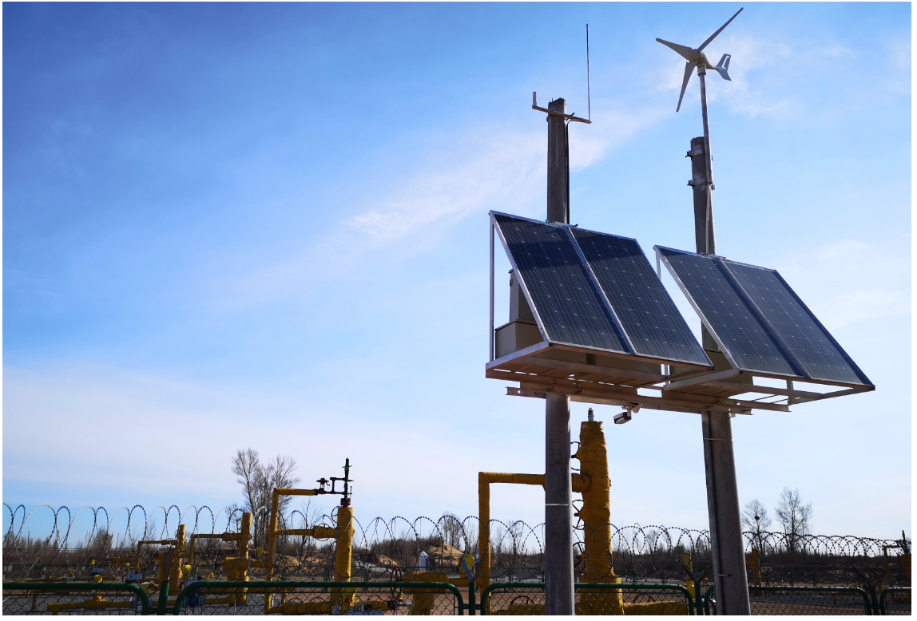
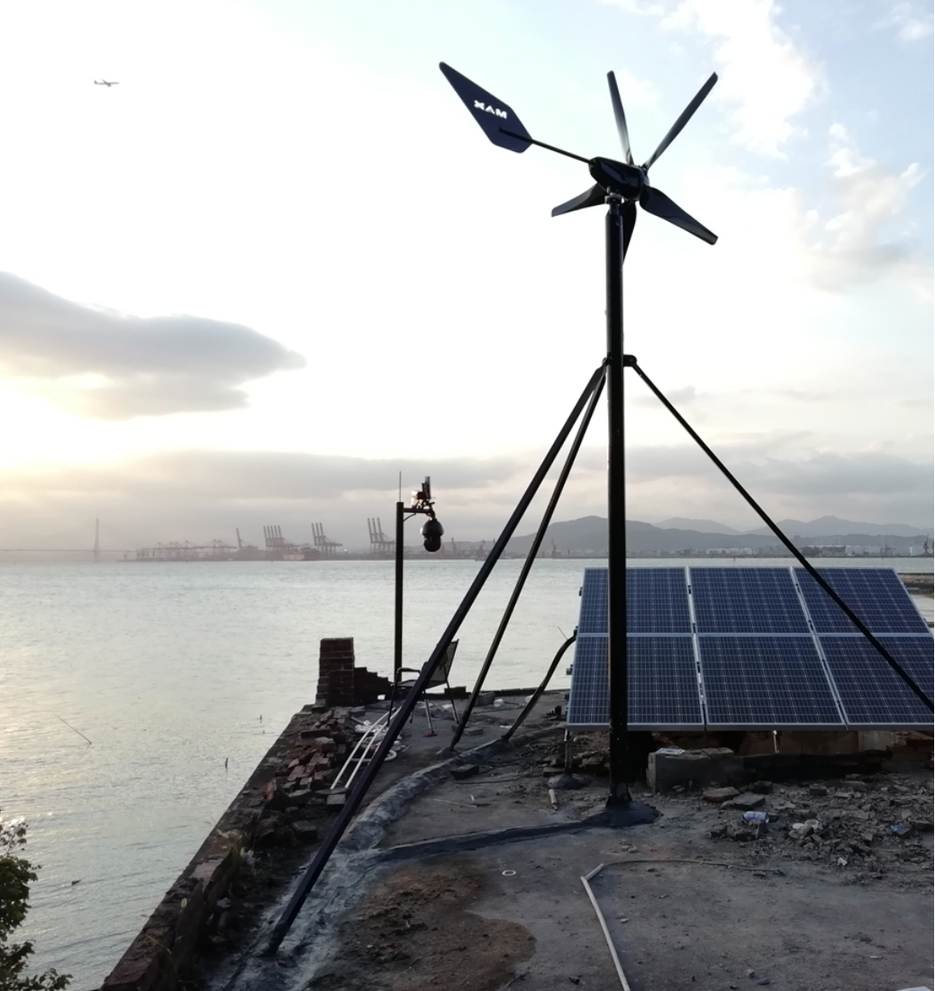
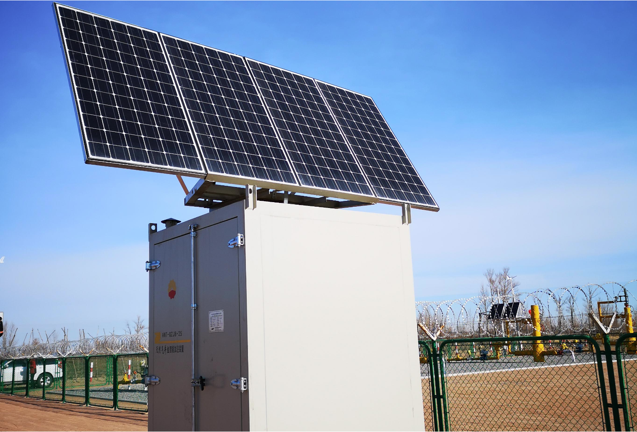
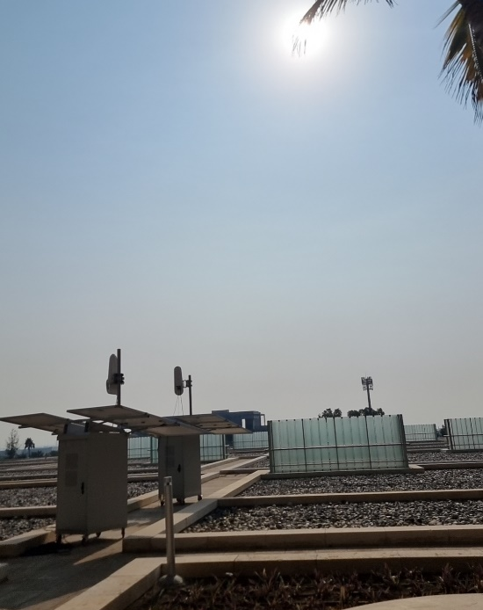
Hybrid Integrated Energy Station (Use Scenario)
Remote Mountain Scenes
Island Scenes
Oil Field Monitoring Scenes
Desert Communication Sites
Small-Scale Industrial And Commercial Scenes

